Slide 1
Module 2: Data Mapping
Siebel EIM training
Notes:
Data Mapping
COMPANY CONFIDENTIAL AND PROPRIETARY INFORMATION — DUPLICATION IS PROHIBITED
34.<number>
Time: Lecture: 25 – 30 minutes; labs: 80 – 95 minutes
Intent: To explain how to determine which EIM columns are necessary to populate the target base table columns.
Flow: Identifying target base tables and columns using the Siebel application and Siebel Tools; mapping data into identified columns; determining required columns mapping considerations; and documenting mappings.
Key Terms:
Attribute
Entity
Destination table and columns
Business component
Base table
Column
Please note: Faculty-specific notes are italicized.

Slide 2

Module Objectives
After completing this module you will be able to:
  Determine appropriate interface (EIM) tables and columns to use to perform imports into and deletes from Siebel base tables and columns
  Document how external data maps to EIM tables and base tables
Why you need to know:
  Enables you to construct a strategy for successfully importing and deleting from the Siebel database
Notes:
Data Mapping
COMPANY CONFIDENTIAL AND PROPRIETARY INFORMATION — DUPLICATION IS PROHIBITED
34.<number>

Slide 3
Data Mapping
Data mapping determines:
  Which Siebel base table columns will store external source data
  Which interface (EIM) table columns will be used to import from source to destination
Where data ends up
Source
(external)
Destination
(base)
How to get there
Interface (EIM)
Notes:
Data Mapping
COMPANY CONFIDENTIAL AND PROPRIETARY INFORMATION — DUPLICATION IS PROHIBITED
34.<number>
Usually data mapping is a design activity. It happens up front during the initial stages of the project. Here the focus is more on EIM to base table mappings rather than on external to Siebel database mappings.

Slide 4
Source Data
Analyze external source data
  Which attributes need to be stored?
  Which entity does the collection of attributes represent?
  What relationship(s) does this entity have to other entities?
Customer
M:M
Sales
Person
Entity
Name...
M:M
Attribute
Name...
Decision
Maker
Name...
Notes:
Data Mapping
COMPANY CONFIDENTIAL AND PROPRIETARY INFORMATION — DUPLICATION IS PROHIBITED
34.<number>
This is not specific to a Siebel implementation. Any time you are looking to move or migrate data, you must analyze what the data represents. Entity and attribute are common terms used along with entity relationship diagrams (ERDs).

Slide 5
Siebel Destination
Analyze Siebel destination tables and columns
  Use the sample application to determine business components (BCs), tables, and relationships
  Use Siebel Tools to view tables and columns, business components, and relationships
  Use the data model reference to inspect tables and columns
Account
Position
Contact
Notes:
Data Mapping
COMPANY CONFIDENTIAL AND PROPRIETARY INFORMATION — DUPLICATION IS PROHIBITED
34.<number>
Techniques for exploring the Siebel Data Model were practiced earlier in the course. Since the goal is to move data into the Siebel database, one must understand what the Siebel database has to offer. The engineering teams at Siebel Systems have put significant effort into designing the database. Chances are what you need is in there.
Notice that the base table for each of the three depicted components is S_PARTY, which was defined in previous modules.

Slide 6
Map Source to Siebel Destination
Determine the source mapping to the Siebel destination
  Which Siebel business component represents the external entity?
  Which Siebel base tables and columns will store the source attributes?
Account
Position
Customer
Sales
Person
Name...
Name...
Contact
Decision
Maker
Name...
Notes:
Data Mapping
COMPANY CONFIDENTIAL AND PROPRIETARY INFORMATION — DUPLICATION IS PROHIBITED
34.<number>
Once you understand both sides, external and internal, in the Siebel database, then you must bring the data together. Which external piece ends up where in the Siebel database?

Slide 7
How to Get There
After documenting the source-to-base mappings, determine EIM-to-base mappings using Siebel Tools
Source Entity | Source Attribute | EIM Table | EIM Column | Base Table | Base Column
Customer | Name |  |  | S_ORG_EXT | NAME
Customer | Phone |  |  | S_ORG_EXT | MAIN_PH_NUM
 | Address |  |  | S_ADDR_ORG | ADDR
 |  |  |  | S_ADDR_ORG | CITY
 |  |  |  | S_ADDR_ORG | ZIPCODE
✓
✓
How to get there?
?
Interface (EIM)
Notes:
Data Mapping
COMPANY CONFIDENTIAL AND PROPRIETARY INFORMATION — DUPLICATION IS PROHIBITED
34.<number>
This is the focus of the module. Once you know where in the Siebel base tables you want data to end up, you must figure out which EIM tables will get it there.
Notice that the spreadsheet lists the EIM column on the left and the base column on the right. This is reversed when looking at the EIM Interface Tables report within Siebel Tools. Ensure that students do not get confused.
It is important to understand what a base table is and how it will be used in the EIM process. Refer to the student note for a base table definition.

Slide 8
Table Relationships
An interface table may populate more than one base table
A base table may be populated by more than one interface table
EIM_ACCOUNT
S_ORG_EXT
EIM_ADDR_ORG
S_ADDR_ORG
Notes:
Data Mapping
COMPANY CONFIDENTIAL AND PROPRIETARY INFORMATION — DUPLICATION IS PROHIBITED
34.<number>
The point of this slide is that depending on the target base table, there may be several EIM tables to choose from.

Slide 9

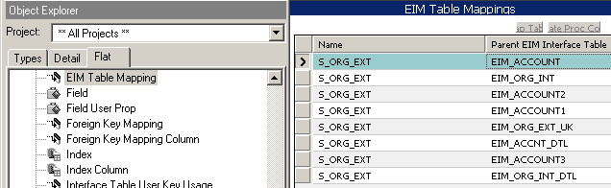
Locate EIM Tables
Locate candidate EIM tables using Siebel Tools
  Example: Locate EIM tables that populate S_ORG_EXT
Flat tab
Query
Result
EIM tables that populate S_ORG_EXT
Note: Use EIM_ tables not _IF tables
Notes:
Data Mapping
COMPANY CONFIDENTIAL AND PROPRIETARY INFORMATION — DUPLICATION IS PROHIBITED
34.<number>
This slide shows a technique for finding what the candidate or potential EIM tables are that will populate a given base table. Stress that students must use EIM_ tables. The graphic adds EIM_ as additional query criteria.

Slide 10
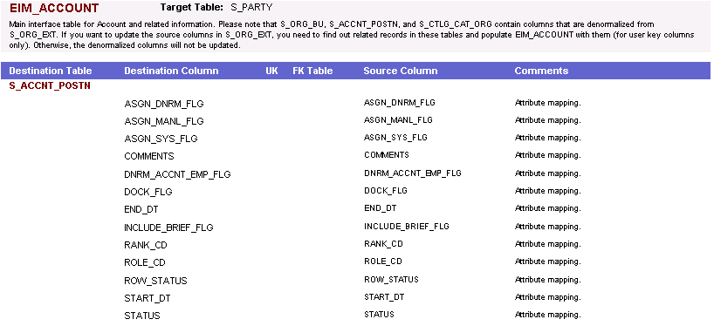
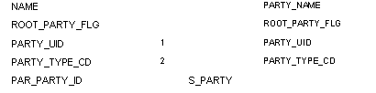
Select EIM Table
Select the EIM table that best maps to the target base tables and columns
  Example: EIM_ACCOUNT may be a better choice than EIM_ADDR_ORG if you want to import into EIM_ACCNT_POSTN in the same batch
Populates
EIM table
Populates
Base column
EIM column
Main base table
Notes:
Data Mapping
COMPANY CONFIDENTIAL AND PROPRIETARY INFORMATION — DUPLICATION IS PROHIBITED
34.<number>
The best EIM table will be the one that allows you to populate the most data. You can use options to limit the target tables during the run. Therefore, having more targets or destinations than you need is not a bad thing. The graphic shows a modified screen capture of the EIM Interface Tables report generated in Siebel Tools and annotates how to read it.
Note: The graphic was modified in order to fit it on the slide.

Slide 11
EIM to Base Mappings
Determine EIM columns that populate target base columns
Determine other EIM required columns to populate the target base table
  Other columns may be required based on required fields in the base table
EIM table
Base table
EIM column
Base column
Notes:
Data Mapping
COMPANY CONFIDENTIAL AND PROPRIETARY INFORMATION — DUPLICATION IS PROHIBITED
34.<number>
You want to determine which EIM columns map to your target columns. Then you must also supply “required” columns whether you want to populate those targets or not. Required means that the base table row will not be populated unless values are supplied in the EIM columns that map to the target columns. Required columns may be user keys or other columns.
See the following slide for examples.

Slide 12

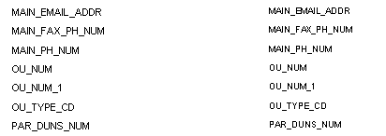
Determine EIM Columns
Determine which EIM column populates the target base column in Siebel Tools
  Example: MAIN_PH_NUM on EIM_ACCOUNT populates MAIN_PH_NUM on S_ORG_EXT
Base column
EIM column
Notes:
Data Mapping
COMPANY CONFIDENTIAL AND PROPRIETARY INFORMATION — DUPLICATION IS PROHIBITED
34.<number>
Notice that the column name on EIM tables is often the same as the column name on the base table, but not always.

Slide 13


Determine EIM Columns
Query Attribute Mappings in Siebel Tools to determine which EIM column populates the base column
  Example: MAIN_PH_NUM on EIM_ACCOUNT populates MAIN_PH_NUM on S_ORG_EXT
Use Flat tab to Query
Base table and column
Result
EIM table and column
Notes:
Data Mapping
COMPANY CONFIDENTIAL AND PROPRIETARY INFORMATION — DUPLICATION IS PROHIBITED
34.<number>
You can also determine mappings using Siebel Tools. It may be quicker to search if you are not sure where to look in the documentation.

Slide 14
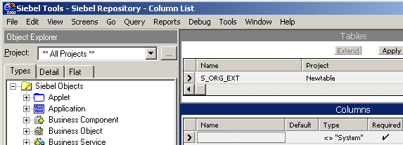
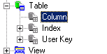
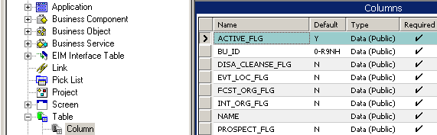
Determine Base Required Columns
Determine required base table columns that do not have defaults (EIM does not recognize non-system default values)
Query Column
Result = required base columns
Default not
recognized by EIM
Notes:
Data Mapping
COMPANY CONFIDENTIAL AND PROPRIETARY INFORMATION — DUPLICATION IS PROHIBITED
34.<number>
Using Siebel Tools to determine required columns is not as straight-forward as referencing the documentation. It is a two-step process. EIM does not recognize non-system default columns. In Siebel Tools, you can query for which columns are the required non-system columns. Notice that even though a default is specified and implemented in the database as a database constraint, EIM preprocesses data and does not recognize the default values.

Slide 15
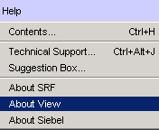
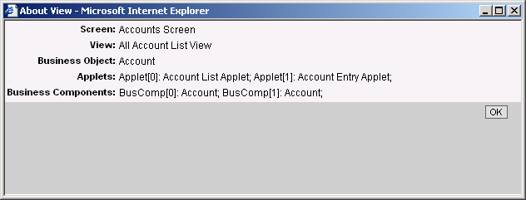
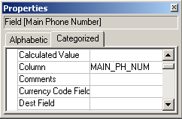
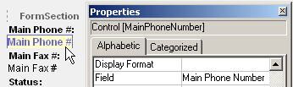
Verify Mappings
Verify that the column mappings match the applet and business component mappings
  Make sure the control on the applet you intend to display maps to the same column you are populating with EIM
Determine object name
Select field to verify column
Use Web Layout Editor to verify field
Notes:
Data Mapping
COMPANY CONFIDENTIAL AND PROPRIETARY INFORMATION — DUPLICATION IS PROHIBITED
34.<number>
This next point, is critical, and it is a common point of failure…
Often there are many people working on the Siebel implementation team providing various special services. Configurators are working with Tools on the front end, database administrators are working with EIM on the back end, designers are data modeling, and so on. It is quite possible that the back-end team will import data into columns that the front-end team is not using and vice-versa. That is why it is critical that the mappings be documented and verified. Run a simple EIM test and make sure you see the data you expect to see through the configured front-end application.

Slide 16
Mapping Considerations
Understand how to enter organization data
  Fill in _BU column with name of the organization
  Leave _BI column blank
    Populated with foreign key during import processing
Understand additional columns that must be populated for party business components
  Examples:
    PARTY_UID
    PARTY_TYPE_CD
    ROOT_PARTY_FLG
Notes:
Data Mapping
COMPANY CONFIDENTIAL AND PROPRIETARY INFORMATION — DUPLICATION IS PROHIBITED
34.<number>
In the EIM Interface Tables report within Siebel Tools, notice that for organization data, the documented mapping is to an EIM table column ending in “_BI” with datatype varchar (15).
For example, for the EIM_ACCOUNT table, the mapping to the S_ORG_EXT..BU_ID column is listed as ACCNT_BI. Instead of using the _BI column, use the corresponding _BU column, populating it with the name of the organization. EIM resolves to the foreign key during import processing. In the above example, you would use the ACCNT_BU column on EIM_ACCOUNT, populating it with the name of the organization, by default, “Default Organization”.

Slide 17
Document Mappings
Document mappings between source, EIM, and base so that everyone has a common understanding
  EIM and configuration tasks are often performed by different people
  Avoid re-doing tasks if team members leave the project
Source Entity | Source Attribute | EIM Table | EIM Column | Base Table | Base Column
Customer | Name | EIM_ACCOUNT | NAME | S_ORG_EXT | NAME
Customer | Phone | EIM_ACCOUNT | MAIN_PH_NUM | S_ORG_EXT | MAIN_PH_NUM
 | none | EIM_ACCOUNT | ACCNT_BU | S_ORG_EXT | BU_ID
 | none | EIM_ACCOUNT | DISA_CLEANSE_FLG | S_ORG_EXT | DISA_CLEANSE_FLG
 | none | EIM_ACCOUNT | PROSPECT_FLG | S_ORG_EXT | PROSPECT_FLG
 | none | EIM_ACCOUNT | PRTNR_FLG | S_ORG_EXT | PRTNR_FLG
Notes:
Data Mapping
COMPANY CONFIDENTIAL AND PROPRIETARY INFORMATION — DUPLICATION IS PROHIBITED
34.<number>
People may come and go from the team. Mappings are critical. They must be documented. Working with spreadsheets to document mappings will be practiced in the lab.

Slide 18
Summary
This module showed you how to:
  Determine appropriate interface (EIM) tables and columns to use to perform imports into and deletes from Siebel base tables and columns
  Document how external data maps to EIM tables and base tables
Notes:
Data Mapping
COMPANY CONFIDENTIAL AND PROPRIETARY INFORMATION — DUPLICATION IS PROHIBITED
34.<number>
Review Question: When mapping organization-related data, which column will you populate on the EIM table?
Review Question: What is the first step in determining your data mapping?

Slide 19
Lab
In the lab you will:
  Map external product data to EIM tables and base tables using
    Siebel Tools
    SQL/Excel
Notes:
Data Mapping
COMPANY CONFIDENTIAL AND PROPRIETARY INFORMATION — DUPLICATION IS PROHIBITED
34.<number>
See lab instructions for details.

